Slide 1
Virtual Texturing in the Documentation of Cultural Heritage The Domitilla Catacomb in Rome
Irmengard Mayer – Claus Scheiblauer
Julian Albert Mayer

Slide 2
A virtual textured model inside the Domitilla Catacomb
Notes:
This is a polygonal model in the Domitilla Catacombe textured with our virtual texturing algorithm. This model is placed inside the point cloud model of the catacomb, which you can see in the background.

Slide 3
Virtual Texturing
An Out-of-Core texture management technique
Rationale
Textures become larger and more detailed
Game designers want virtual worlds to be uniquely textured
Cultural heritage documentation creates uniquely textured models
Connect technique used for games with cultural heritage documentation
Notes:
What is virtual texturing? It is an out-of-core texture management technique, which means that the whole texture resides on hard disk, and only the necessary parts (so called tiles) are streamed to graphics card memory when needed. This technique is useful in areas where textures are large and very detailed. One area is in computer games, where game designers strife to create ever more realistic virtual worlds, and for example buildings should not look all the same. Another area is cultural heritage documentation, where not computer genereated models but models of real monuments shall be shown. So we connected a technique that is used in computer games for documenting cultural heritage, and we combined it in an interactive application with our point cloud viewer.

Slide 4
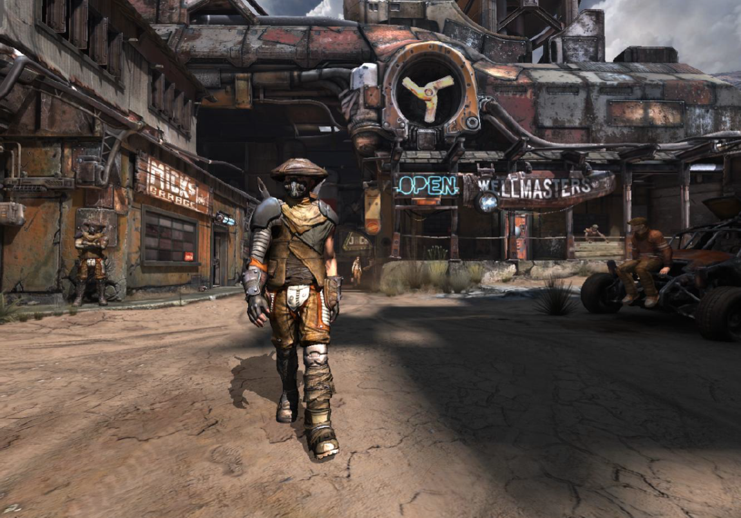
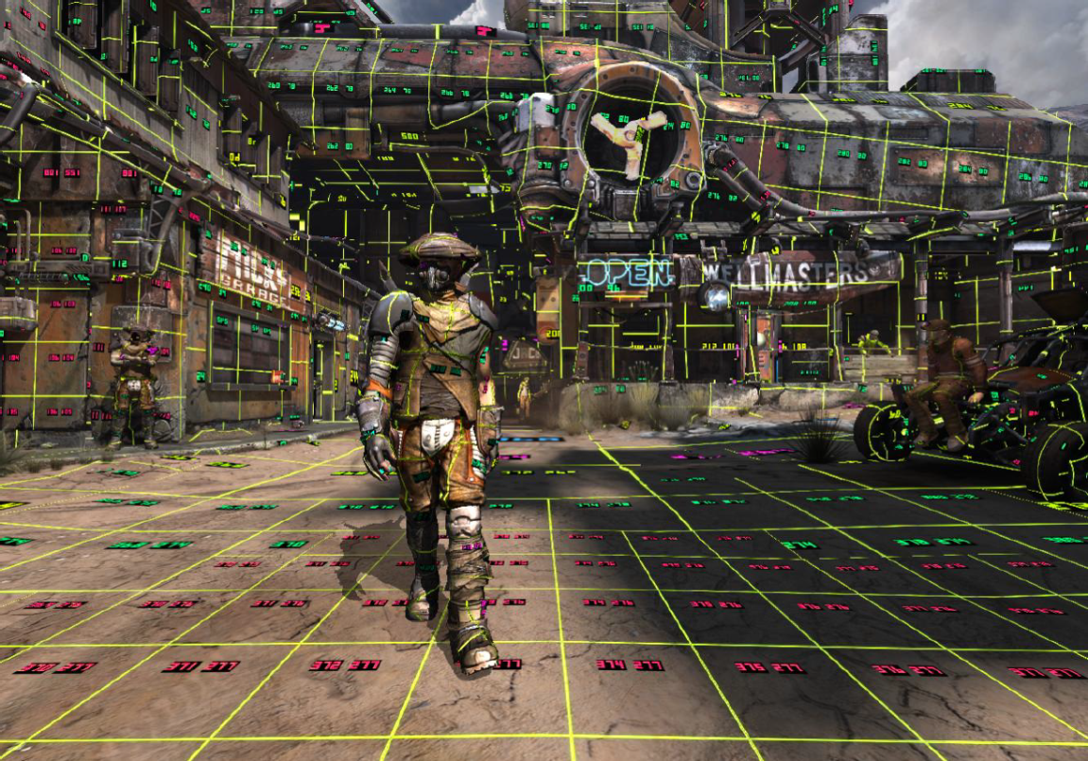
What the user sees
How the objects are textured
Images copyright by id Software
Notes:
These two images shows how virtual texturing works in a scene. The textures are divided into tiles, and it is determined which tiles are visible for the current viewpoint. In the front the tiles are representing a higher level of detail, and in the back the tiles represent a lower level of detail. Not only the distance to the user determines the level of detail of the tiles, but also the angle at which the user looks at the objects surface.

Slide 5
Ingredients for a Virtual Texturing System
The Virtual Texture
In its base level it is a texture atlas of all images used for texturing
Subdivided into tiles
Levels-of-Detail at tile granularity
Tile determination system
Which tiles are needed for rendering the current frame
Tile streaming system
Stream tiles from disk to graphics card
Map tiles to geometry
Transform texture coordinates of geometry to use tiles loaded on GPU
Notes:
The ingredients for a virtual texturing system are the following: first a virtual texture is necessary, which resides on disk. At the lowest level (this is the level with the original resolution of the images) it resembles a texture atlas. in a texture atlas all images are combined into one huge texture. This texture is then again divided into quadratic tiles, with a sidelength of for example 256 pixels. All tiles for one virtual texture have the same size. From this tiled texture atlas the mipmap chain is created, which is a sequence of ever smaller images always by a factor of 2, and down to the size of one tile. So the texure atlas plus the mipmap chain for the levels of detail make up the virtual texture. The tile determination system decides which tiles are necessary for the current view, and it does so for every pixel. The tile determination happens in a pre-render pass every frame. The tile streaming system uses the information from the tile determination pass to request the necessary tiles from hard disk if they are not currently available on the graphics card, and stores the tiles in the so called physical texture on graphics card memory. The last part is mapping the tiles that are on the graphics card to the geometry. Here a mapping from texture coordinates is necessary, because the geometry has texture coordinates that point into the virtual texture, and the tiles have new texture coordinates corresponding to the physical texture. This mapping is done with the pagetable texture, which stores the coordinates of the tiles in the physical texture.

Slide 6
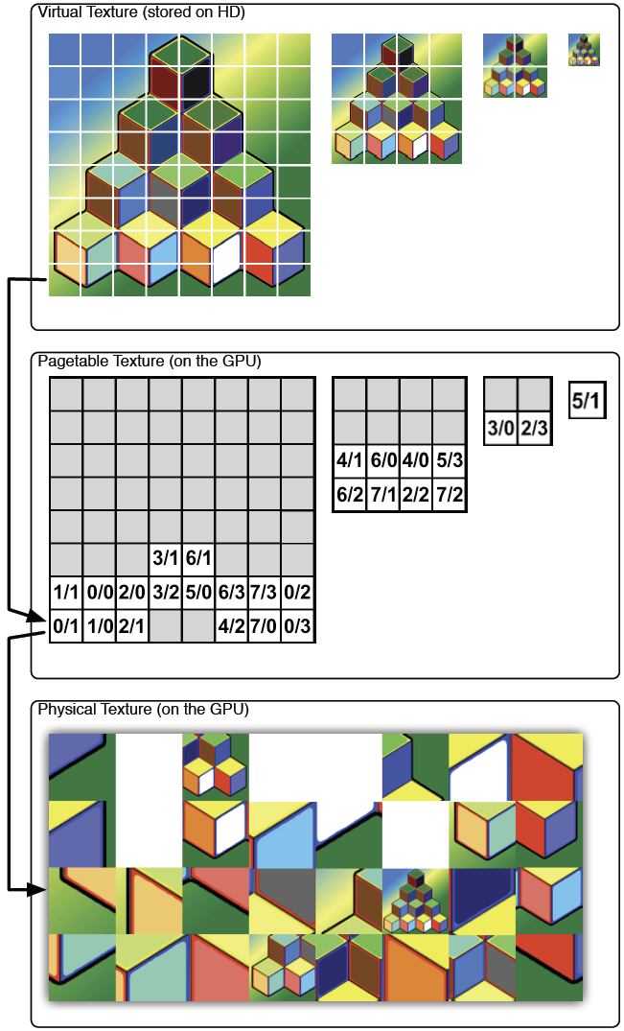
Virtual texture
stored on disk
Pagetable texture
stored on GPU
Physical texture
stored on GPU
Notes:
Here the three different textures that are used for the last step in the virtual texturing algorithm are shown in an overview. Pagetable texture is a 1:1 mapping of the tiles in the virtual texture to the texels in the pagetable texture. The pagetable texture stores the coordinates of the tiles in the physical texture, and the tiles are finally sampled from the pysical texture.

Slide 7
Demo
~ 30 GB point data
~ 50 GB texture data
965 images used for texturing
41 textured models
Point cloud consists of about 2 billion points
GPU with 3GB video RAM

